Slide 1
Secure Web Programming
Lecture 13 revision & exam
Amanda.Lunt@utas.edu.au
Soonja.Yeom@utas.edu.au

Slide 2
Topics
Secure Web Programming
Week13
Week13
Review
Review
Basic Web Programming
Web Security
Adv. Web Programming
Fundamentals – protocol, CS model, etc.
HTTP Protocols, Storage
Advanced Web Applications
Human Computer Interaction with Web Page Design
Security Issues and Technologies
Session management
Client-side Scripting Language and Document Object Model
Secure Programming and Users
Common Gateway Interface
Server-side Scripting Language and Privilege configuration
Encryption and Authentication
Advanced Security Issues

Slide 3


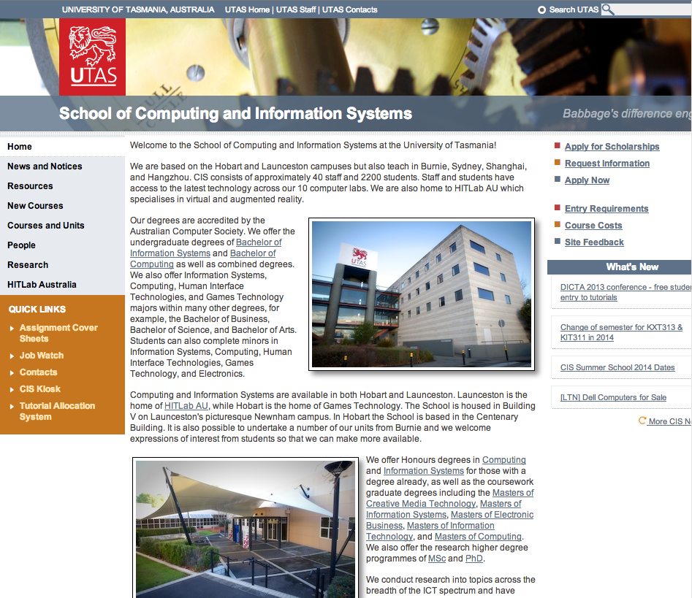
Lecture 1 : History, Concept and Direction
http://www.cis.utas.edu.au
HTTP request message
HTTP Response message
Request: “Could you send me the content?”
Response: “Here you go”
Web Client
CIS Host
Web Servers
There are 3 key components of web page, when writing pages, these components should be kept as separate as possible
The semantic structure of the web page
The appearance of the web page
The behavior of the web page

Slide 4


Lecture 2 : Client-side Scripting and DOM
Client-side scripting
JavaScript, Action-Script, Dart, VBScript
Client-side scripting
- Possible condition for displaying the content
- Disadvantages
Request for the content of the webpage
Script Executed
File Output
Client computer
Server

Slide 5
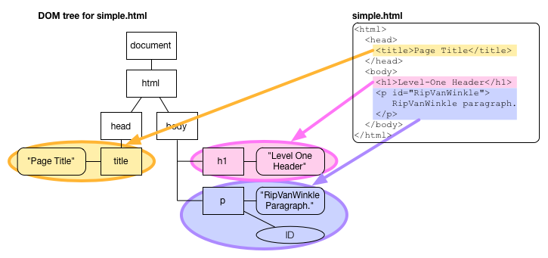
Lecture 2 : Client-side Scripting and DOM
Document Object Model
a standard way for accessing and manipulating HTML documents
Node Tree
Node Tree structure

Slide 6
Lecture 3 : Server-side scripting
Server-side: script is executed by the server before being shown to the client
Server-side scripting
- Possible condition for displaying the content
Advantage
Disadvantage
Request for the content of the webpage
Script Executed
File Output
Client computer
Server

Slide 7
Lecture 3 : Server-side scripting
Built-in variables containing information from Web server, environment and user input
Example
$_SERVER: an array containing information such as headers, paths, and script locations
$_COOKIE: variables provided to script via HTTP cookies
$_ENV: variables provided to script as part of the server environment.
$_GET: variables provided to script via GET method.
$_POST: variables provided to script via POST method.
$_FILES: variables provided to script via file uploads.
$_SESSION: variables registered in a session.

Slide 8
Lecture 4: HTML Form with PHP and Database
Web browser
Web Server
Database
PHP
MYSQL
HTML
HTML Form + Super global variable
ex) $_GET, $_POST
Connection
SQL

Slide 9
Lecture 4: HTML Form with PHP and Database
INSERT INTO table_name
(column_name, column_name, …)
VALUES
("first_value", "second_value", …);
UPDATE table_name
SET column_name1=expression1,
column_name2=expression2, …
WHERE conditions;
DELETE FROM table_name WHERE condition;
SELECT column_name1, column_name2,… FROM table_name;
SELECT column_name1, column_name2, … FROM table_name WHERE condition;
Don’t forget JOIN and UNION

Slide 10
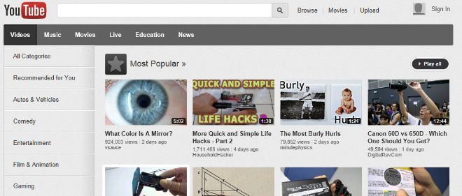
Lecture 5: Database and State Management
How does the server know whether you have logged in or not?
Session? Cookie?

Slide 11
Lecture 6: State and Header Management and Security
Text messages with a set format –contain all of the communication between client and server
Request message (sent by client)
Response message (sent by server)
Message structure is same for both request and response.
Request message
Response message
Called the request line – 3 parts
Method (e.g. GET, POST)
Uri of request resource
HTTP version being used
Initial Line
Called the status line – 3 parts
HTTP version
Response code
Response phrase
Contain information that allows the client to:
Provide information about itself to the server
Give additional details about the nature of the request that the client is making
Allow the client to have greater control over how its request is proceed and how a response is returned by the server or intermediary
Headers
Contain information about such things as:
the media type of the content sent to the recipient
a new URL that the server is instructing the client to use in place of the one the client initially requested
cookies that the client should store
Blank Line
May contain data that has been submitted from a form
Optional Contents
The actual contents of the resource requested (e.g. the html code)

Slide 12
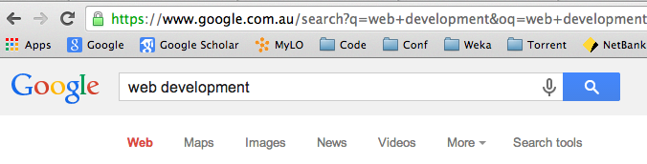
Lecture 7, 8: Security (Issue, Programming)
Phishing attacks
Fool the users
How to prevent
Network attacks
Attack the connection
How to prevent
Code injection attacks
Attack the server or browser
How to prevent
HTTP
IMAP
LDAP
SSL
TCP/IP

Slide 13
Lecture 7, 8: Security (Issue, Programming)
Symmetric, Public, Hash
Symmetric Key Encryption
Public Key (Asymmetric Key) Encryption
ajsdhj
asdklajs
original
message
key
encrypted
message
key
original
message
ajsdhj
asdklajs
original
message
public
key
encrypted
message
private
key
original
message

Slide 14

Lecture 9: AJAX and Web applications
Classic Web Application Model
AJAX Web Application Model
Request message
Query
Database
Response message (HTML+CSS+JavaScript…)
Data
Client computer
Server
User Interface
JavaScript call
AJAX Engine
Request message
Query
Database
Response (HTML + CSS Data…)
Response message (Data – plain text, XML, or Json Data)
Data
Server
Client computer

Slide 15
Lecture 10: HCI
What to consider?
Content
Target audience
Organising (Navigation, Site structure)
Visual appearance
Usability
Accessibility
Why important?
How eventuate it?

Slide 16

Lecture11: Dynamic Web Page solution
Client Computer (Browser)
Web Server
Web server send the request message to the CGI program in environment variables
the web server can send data to the child CGI process via the child's STDIN
the web server reads data that the child sends to its STDOUT, and passes this back to the web client
Database
CGI Program

Slide 17
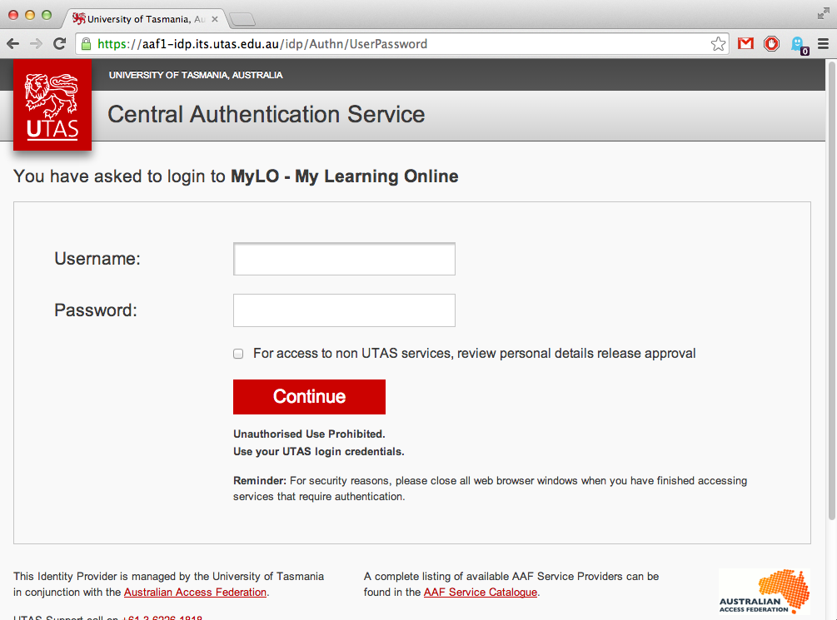
Lecture 12: Code Management :MVC
Browser
Model
Controller
View
The data
The Interaction
The UI
Database

Slide 18
EXAM
15 June 2018

Slide 19
Exam Preparation
All the examinable material has now been covered!
In-semester assessment
Assignment 1 + Assignment 2 + Tutorial works = 50% of unit marks
Examination = 50% of unit marks
Preparation – structure of the exam
Lecture notes, self-studies, and tutorials

Slide 20
Exam
Duration: 2 hours
No material allowed
Weight : 50% of the overall mark

Slide 21
Please…
Do
Answer ALL questions.
Do Not
Spend too much time on one question.

Slide 22
Exam Structure
Total 120 marks
Section A:
5 marks x 16 questions = 80 marks
Section B:
10 marks x 4 questions = 40 marks

Slide 23
Section A
Total 80 marks
Section A contains 12 questions, each question is worth 5 marks.
Allocate approximately 80 minutes on section A.
Sample types of questions.
Explain…
Compare…
Describe…
What is…

Slide 24
Section B
Total 40 marks
Section B contains 4 questions, each question is worth 10 marks
Allocate approximately 40 minutes on section B.
Both theoretical and practical questions.
Sample types of questions.
Evaluate…. And suggest…
Explain …
Discuss…

Slide 25
Exam Strategy
Answer the question that you are asked.
Explain the difference between require() and include().
good answer (5/5)
Those are identical, except upon failure. If there is an error:
require will produce a fatal error and stop the script.
include will only produce a warning and the script will continue
bad answer (2?/5)
Identical, except upon failure.

Slide 26
Exam Strategy
Marks allocated
HTTP transactions are said to be stateless. What does this mean? And what is the weakness of them being stateless?
Answer 1
Each transaction is not related to any other transaction. It may be necessary to include additional information in every request, and this extra information will need to be interpreted by the server.
Answer 2
In computing, a stateless protocol is a communications protocol that treats each request as an independent transaction that is unrelated to any previous request so that the communication consists of independent pairs of request and response. A stateless protocol does not require the server to retain session information or status about each communications partner for the duration of multiple requests. In contrast, a protocol which requires keeping of the internal state on the server is known as a stateful protocol. Examples of stateless protocols include the Internet Protocol (IP) which is the foundation for the Internet, and the Hypertext Transfer Protocol (HTTP) which is the foundation of data communication for the World Wide Web

Slide 27
Exam techniques
In the exam
Read the instructions
Read the questions VERY CAREFULLY
Overview at the beginning
Detailed before tackling
Reread exam questions
Before starting to write answer
If question seems to be taking longer than allocation
Stick to time allocation

Slide 28

Study techniques
Revise
Lecture notes
Self-studies
Tutorial work

Slide 29
Thank you
Any Questions

